Slide 1


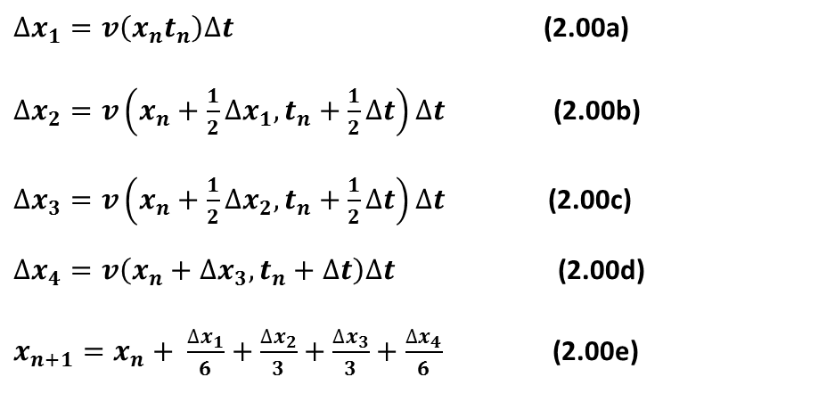
Runge-Kutta
$∆x_{1}=v\left(x_{n}t_{n}\right)∆t$ (2.00a)
$∆x_{2}=v\left(x_{n}+\frac{1}{2}∆x_{1},t_{n}+\frac{1}{2}∆t\right)∆t$ (2.00b)
$∆x_{3}=v\left(x_{n}+\frac{1}{2}∆x_{2},t_{n}+\frac{1}{2}∆t\right)∆t$ (2.00c)
$∆x_{4}=v\left(x_{n}+∆x_{3},t_{n}+∆t\right)∆t$(2.00d)
$x_{n+1}=x_{n}+ \frac{∆x_{1}}{6}+\frac{∆x_{2}}{3}+\frac{∆x_{3}}{3}+\frac{∆x_{4}}{6}$(2.00e)
Testare
Implementare

Slide 2
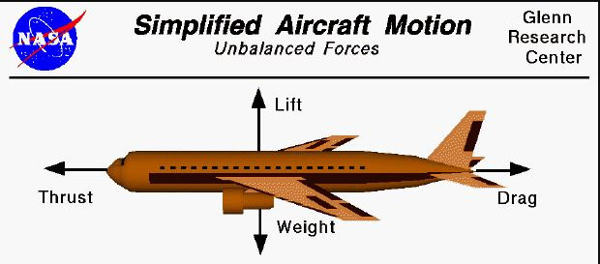
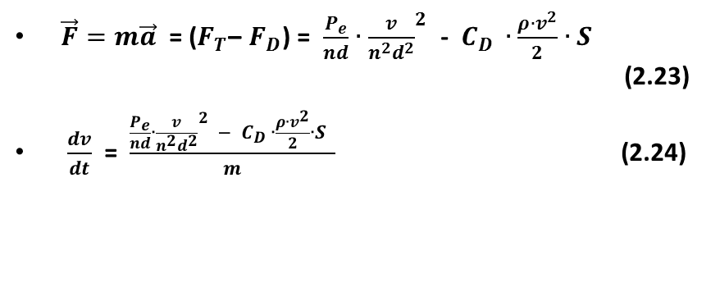
Diagrama forțelor:
$\vec{F}=m\vec{a}$ = ($F_{T}$– $F_{D}$) = $\frac{P_{e}}{nd}∙{\frac{v}{n^{2}d^{2}}}^{2}$ - $C_{D }∙\frac{ρ∙v^{2}}{2}∙S$ (2.23)
$\frac{dv}{dt}$ = $\frac{\frac{P_{e}}{nd}∙{\frac{v}{n^{2}d^{2}}}^{2} − C_{D }∙\frac{ρ∙v^{2}}{2}∙S }{m}$ (2.24)

Slide 3
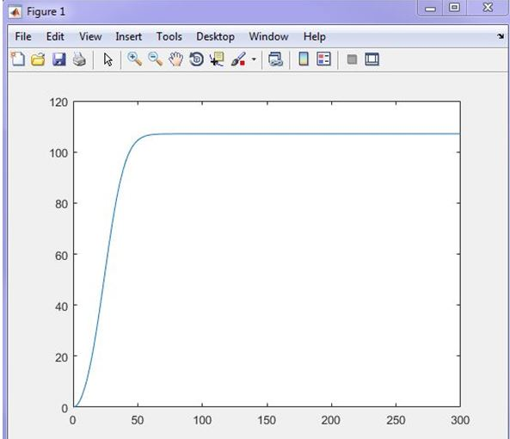
Rutina R-K în Matlab
F_xy = @(t,v) t*(thrust-(Cd*(S*v*v/2)*1.225))/mass;
for i=1:(length(x)-1)
% rutina de calcul Runge-Kutta
k_1 = F_xy(x(i),y(i));
k_2 = F_xy(x(i)+0.5*h,y(i)+0.5*h*k_1);
k_3 = F_xy((x(i)+0.5*h),(y(i)+0.5*h*k_2));
k_4 = F_xy((x(i)+h),(y(i)+k_3*h));
y(i+1) = y(i) + (1/6)*(k_1+2*k_2+2*k_3+k_4)*h;
end
plot(x,y);
Grafic viteză-timp

Slide 4
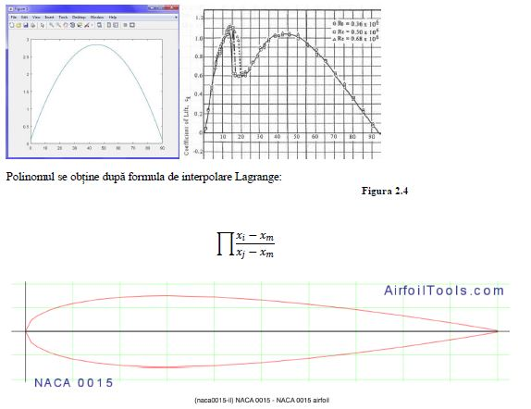
Aproximare polinomială
sym Cl,x
x = 0:0.1:90
Cl= -0.0013571 .* x .* x + 0.122143 .* x + 0.1
plot (x,Cl)

Slide 5
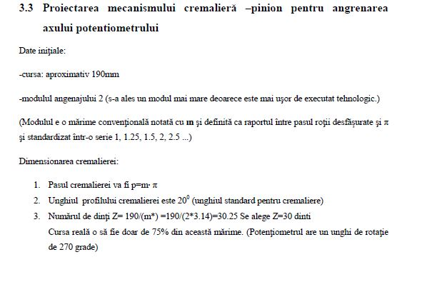

Slide 6
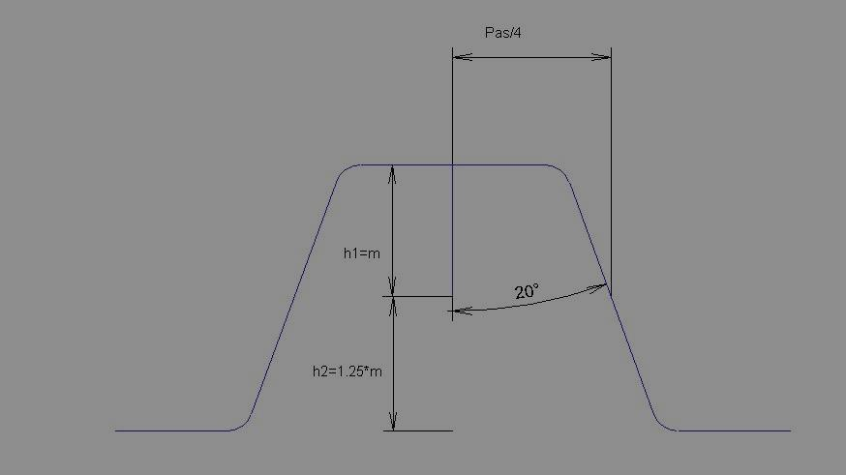
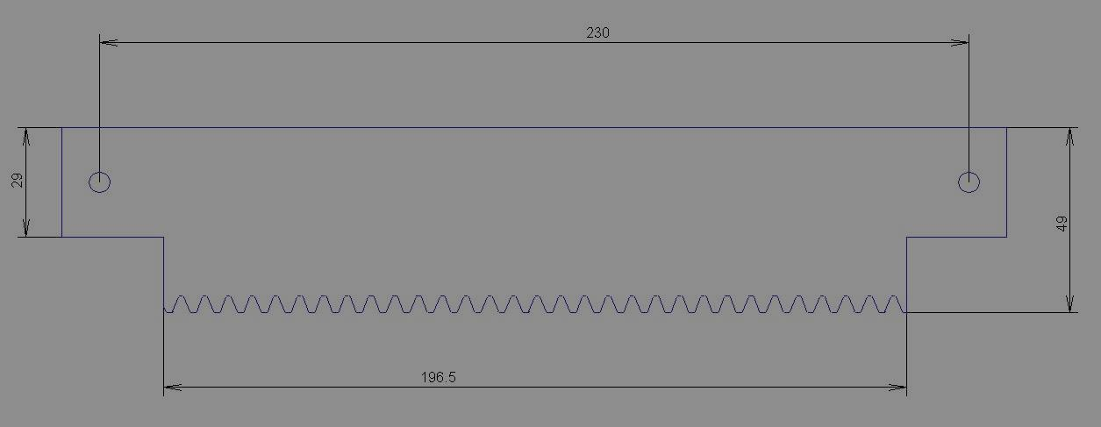

Proiectarea mecanismului cremalieră –pinion pentru angrenarea axului potențiometric
Pasul cremalierei p=m$∙$ π
Numarul de dinți Z = 190/ 2 * 3.14 → Z = 30 dinţi

Slide 7
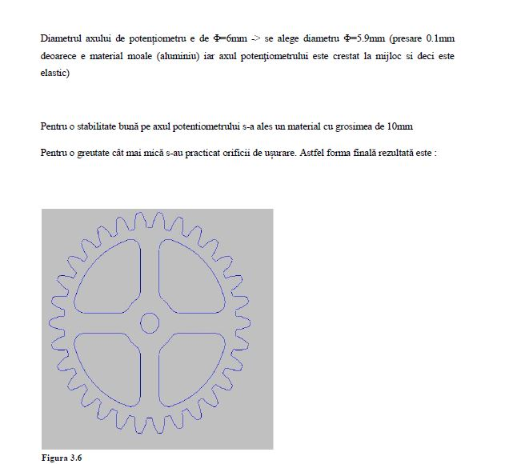

Slide 8
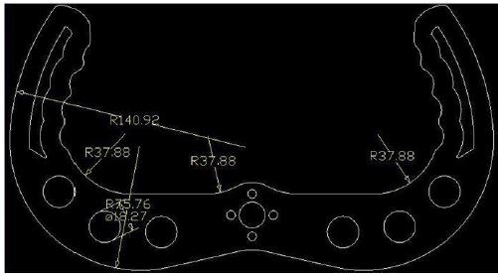

Slide 9
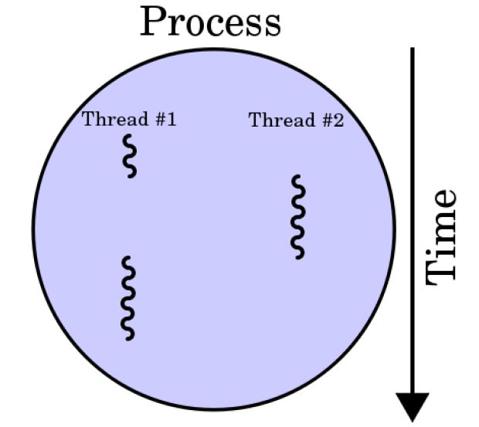
Threading
Thread chipKit;
try {
if(serial.IsOpen) {
serial.Close(); serial.Open(); }
else {
serial.Open();
} }

Slide 10
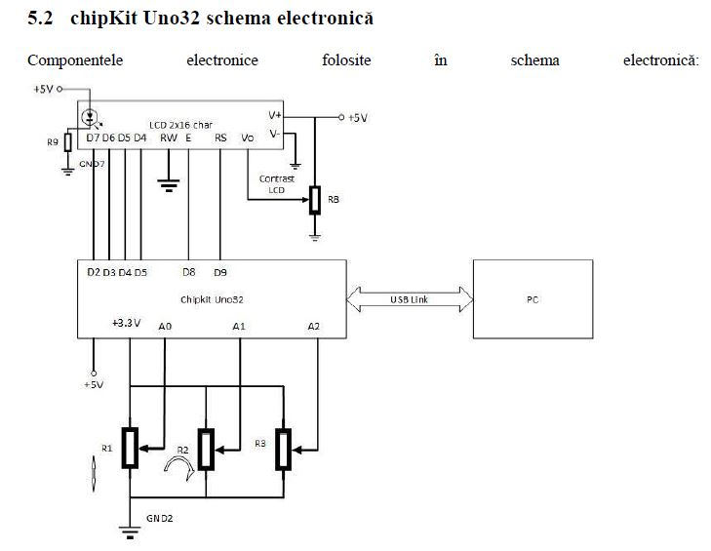

Slide 11
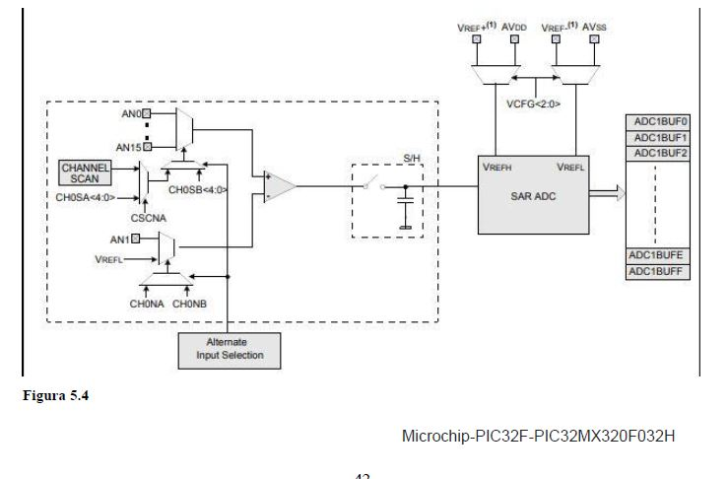
CAN PIC32

Slide 12
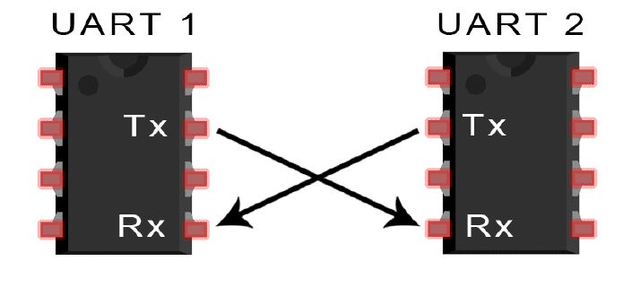
Interfaţa serială

Slide 13
